Slide 1
Data Analysis and Visualization of Airbnb Dataset

Slide 2
Introduction
In this project I am doing the exploratory data analysis, visualizations, interactive plots, animations and lots of other interesting insights into the Airbnb data.
New York city has been one of the most popular cities for travel and hottest market for Airbnb. Airbnb is an online-based marketing company that connects people looking for accommodation (Airbnb guests) to people looking to rent their properties (Airbnb hosts) on a short-term or long-term basis. The dataset contains the real-world data of Airbnb of New York city and describes the listing activity and metrics in NYC, NY for 2019.

Slide 3
The dataset includes the listing activity of and metrics in NYC, for 2019. This dataset contains prices for listing in different neighbourhood groups within different neighbourhood cities. It also contains different factors like property types, reviews, and availability of listings, that can affect the price for the listing. The data has 48895 observations and 16 attributes.
Dataset is available on Airbnb: http://insideairbnb.com/get-the-data.html and can be downloaded from: https://www.kaggle.com/dgomonov/new-york-city-airbnb-open-data.
Response variable: Price per night
Explanatory variables: price, name, host id, host name, Neighbourhood-group, neighbourhood, latitude, longitude, room-type, minimum-nights, number of reviews, last review, review per month, calculated host listings, and availability 365 days.

Slide 4
Problem Statement
One of the biggest challenges for companies is to maintain positive customer experience along with having a financially profitable business model for property owners. How factors are affecting the price for the Airbnb listing in NYC? What is the overall location distribution of Airbnb NYC? Which neighbourhood has a better average price for the Airbnb listing?
OUR GOAL
Our goal is to build a statistical model to effectively predict the price for the listings and company can use this model to come up with a price suggestion for the future listings.

Slide 5
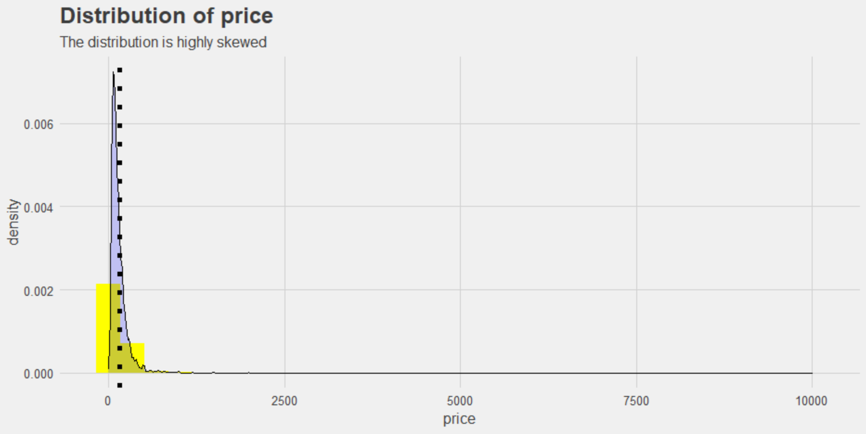
The most important (target) variable is price.

Slide 6
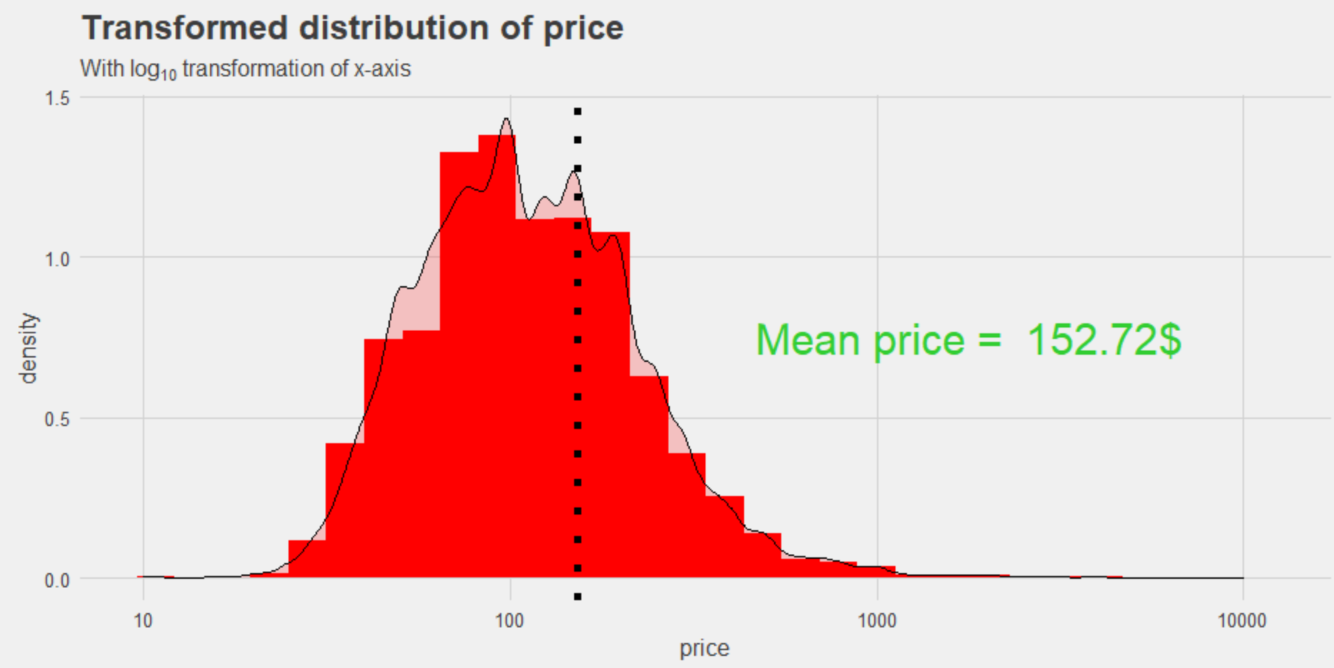
The original distribution of price is highly skewed. Which will not make better visualization with other variables. We used logarithmic transformation for better insight view of price distribution. Logarithmic scale is defined with in range of 10.

Slide 7
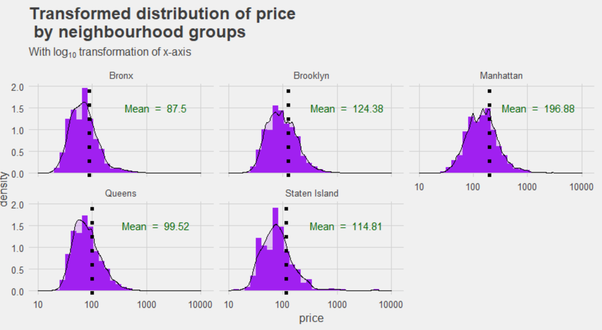
New York City consist of five neighbourhood areas: Manhattan, Brooklyn, Queens, The Bronx, Staten Island.
It can be useful to visualise the distribution of price for every neighbourhood area.

Slide 8
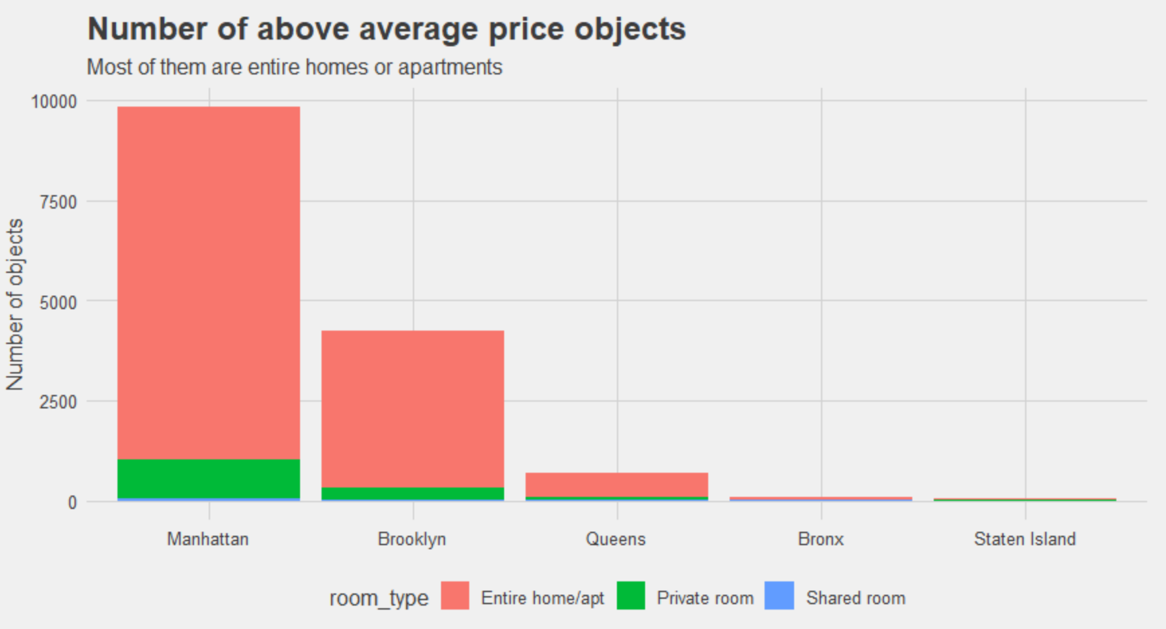
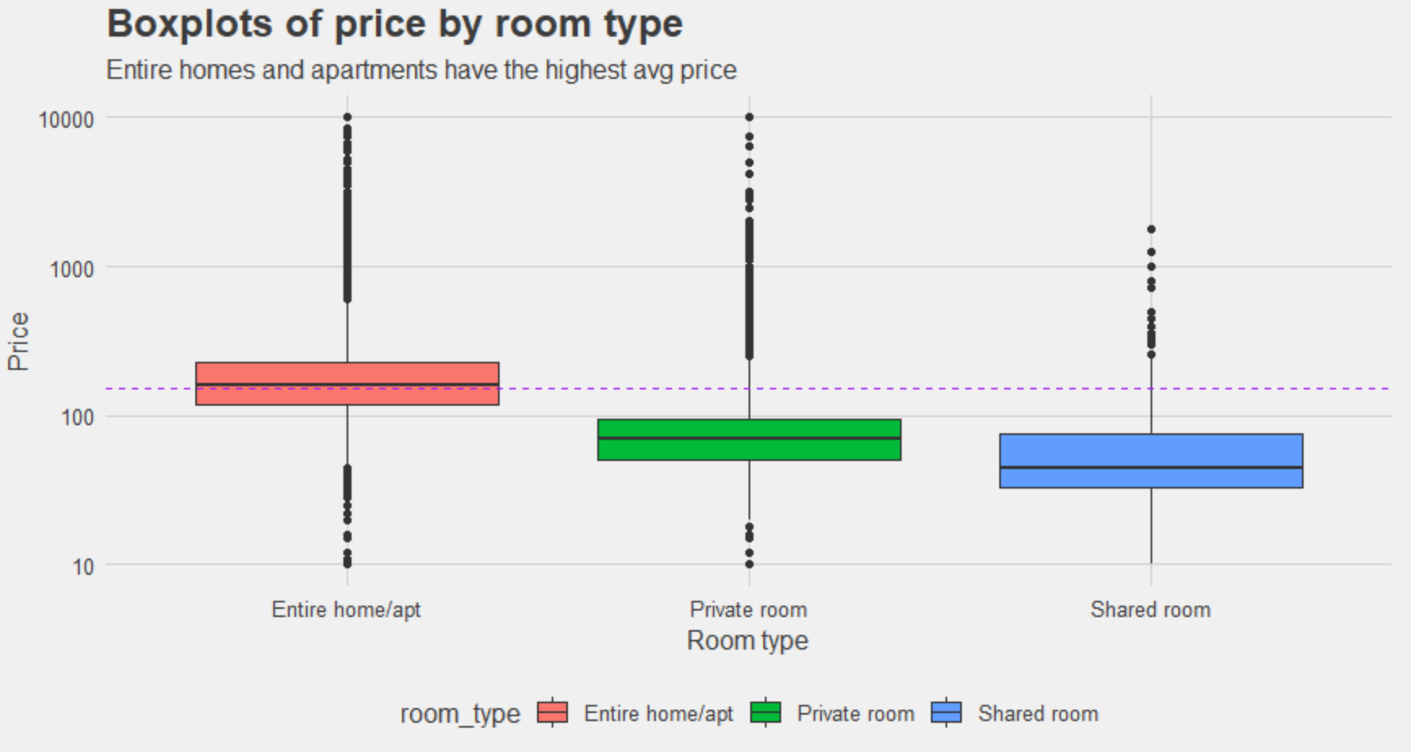
We can also investigate price by room type:
Entire home or apartment
Private Room
Shared Room
As expected, entire home or apartment type has the highest average price. It was also expected that shared rooms would have lower price than private rooms.

Slide 9
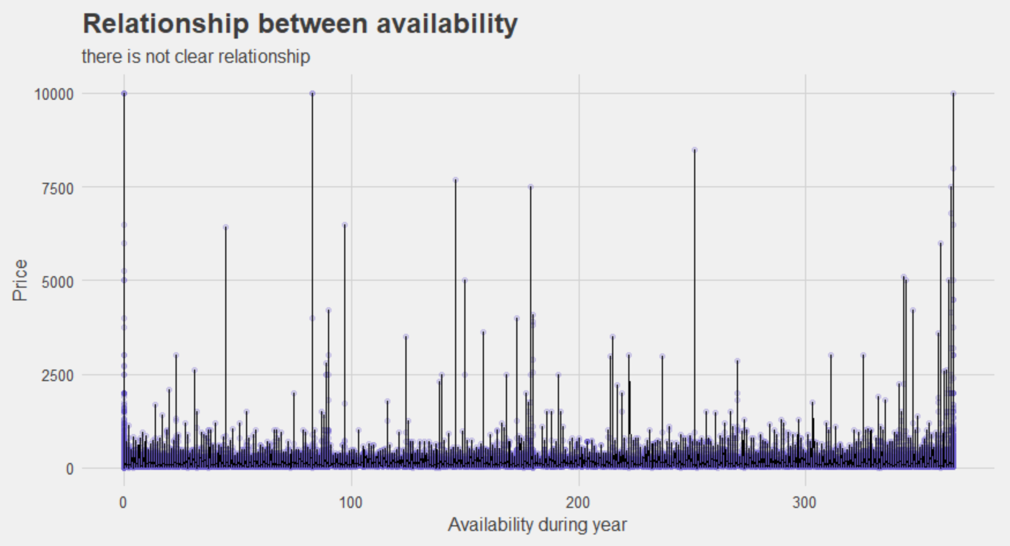
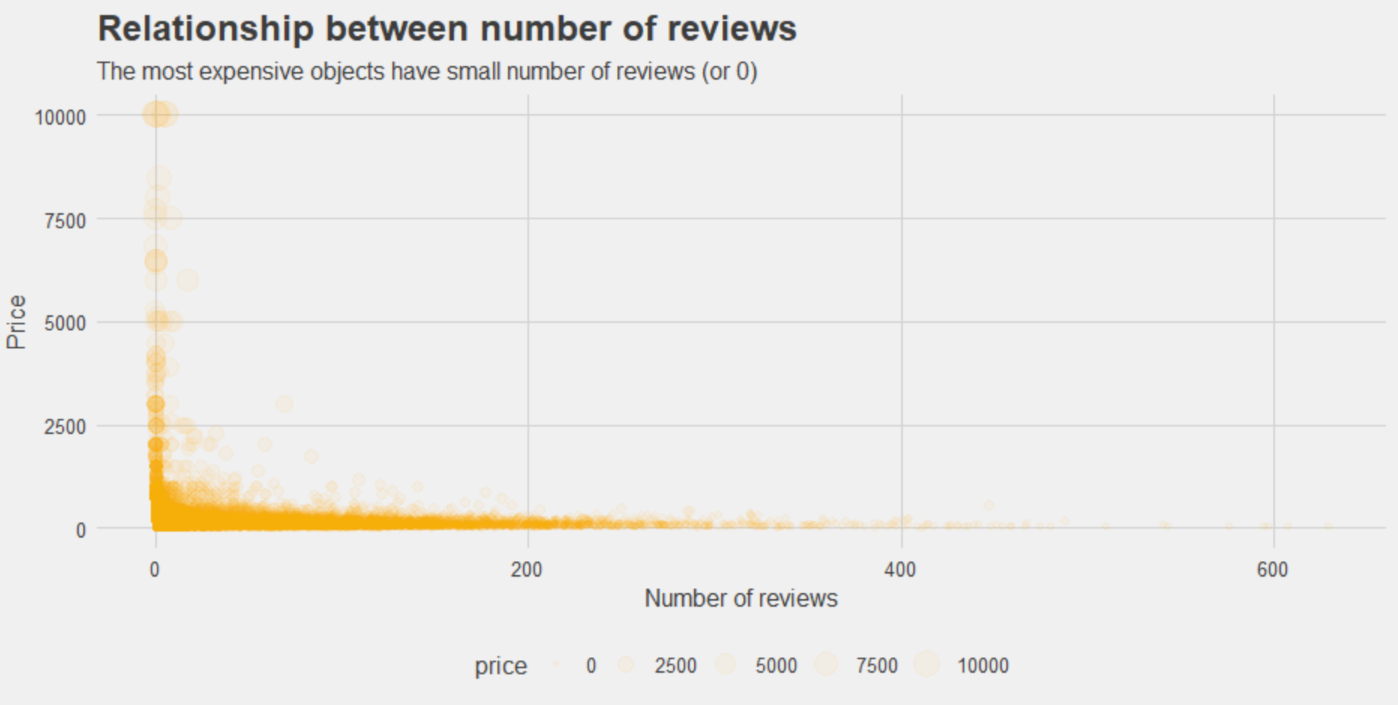
It’s hard to see clear pattern, but there’s a lot of expensive objects with few available days and many available days in fig (1).
The above plot shows low price listings have higher number of reviews and high price listings have low number of reviews. That shows a negative relationship in fig(2).

Slide 10
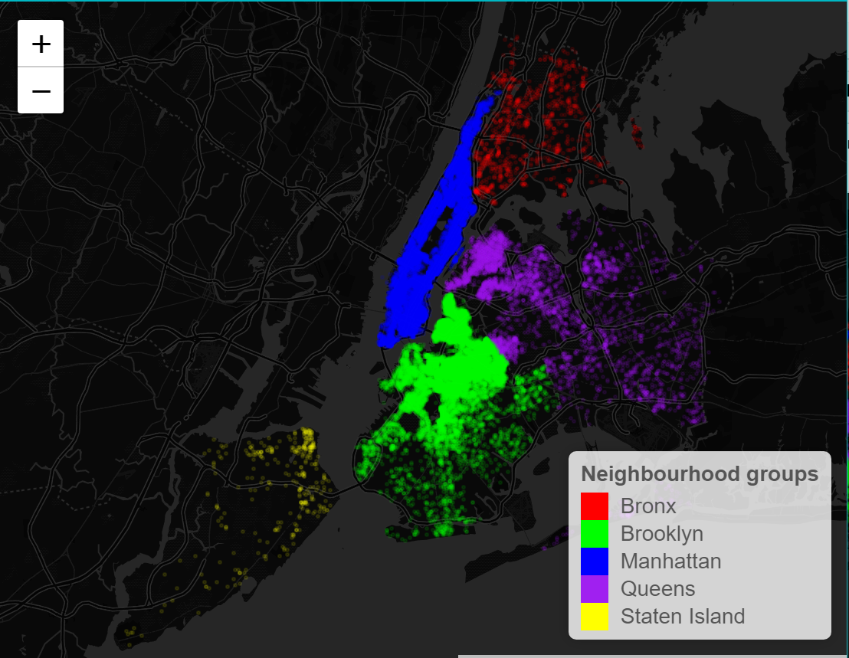
Manhattan has the highest number of objects while it’s the smallest neighbourhood group by area. That can be explained by the fact that it’s the most popular neighbourhood group with biggest GDP.
Followed by Brooklyn is 2nd highest number in the neighbourhood.

Slide 11
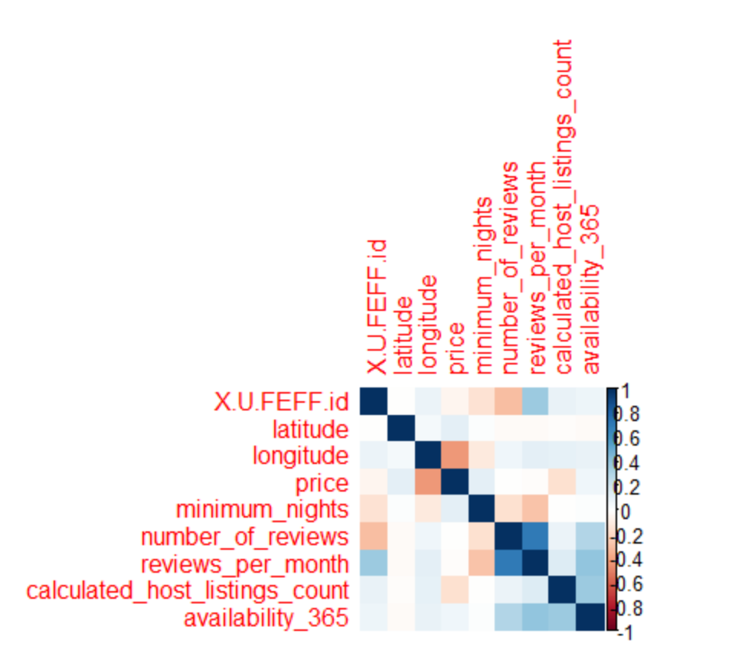
Target variable price has positive correlation with minimum number of nights, availability of 365 days. Calculated host listings have negative correlation with price and the above graph also shows least correlation with number of reviews.

Slide 12
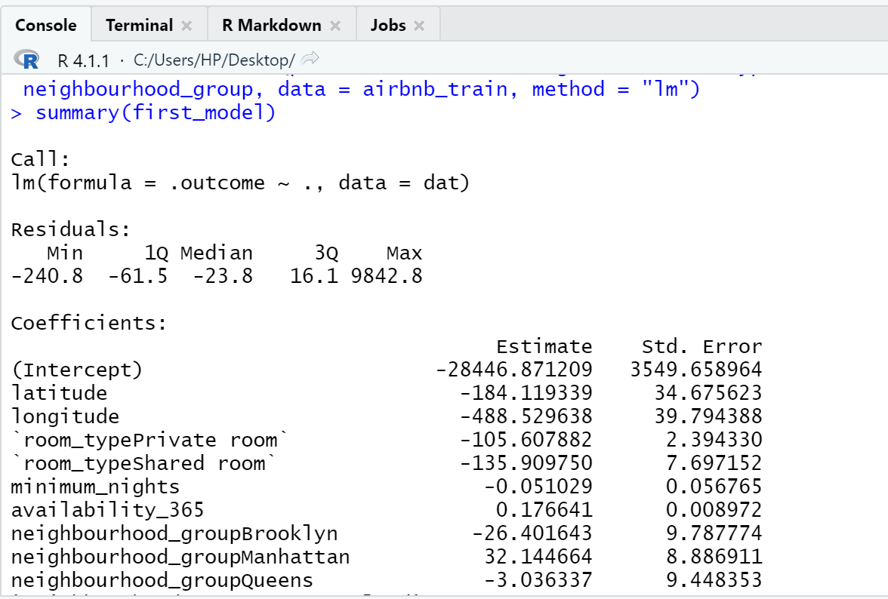
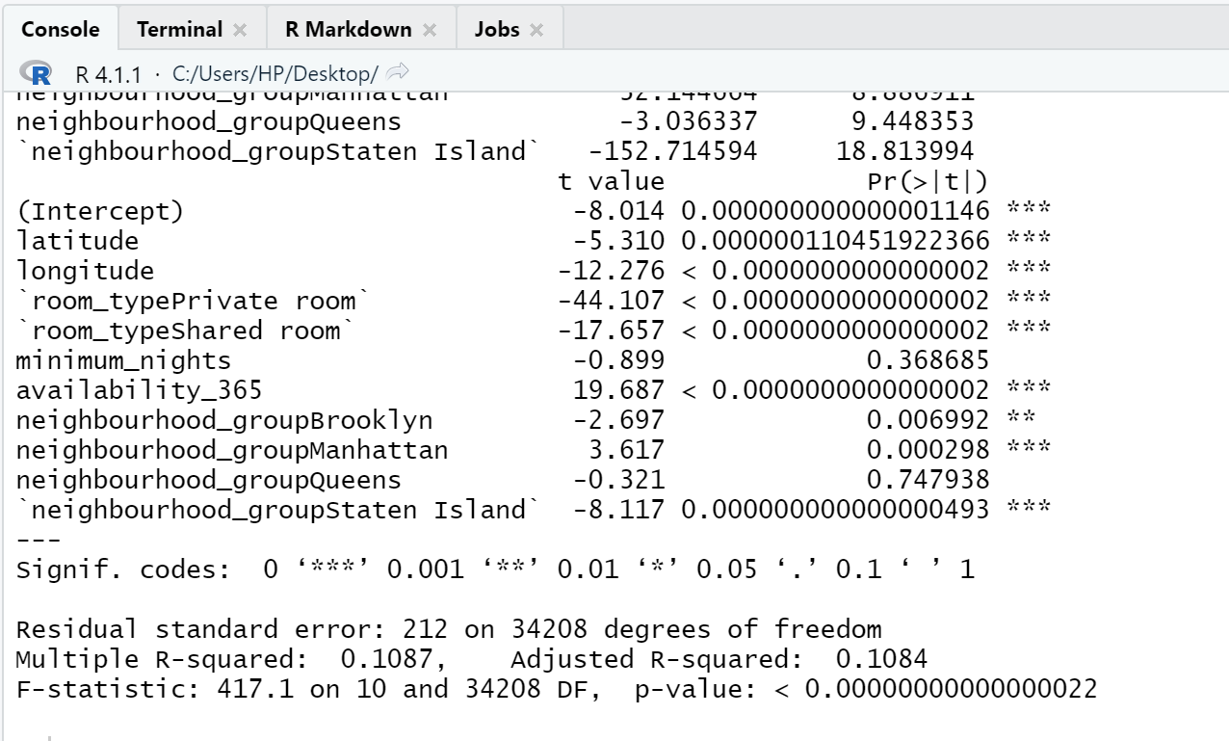
This model is not so good. Median residual error is -23.8, while it should be near 0.
Adjusted R2=0.10 is also not so good.
Firstly, we will check the most correlated variables from correlation plot that weather these variables have impact on price per night or not.
So, in 1st model we compare price with minimum nights, number of reviews, reviews per month and availability 365 days.
All variables are significant in this model. We kept all variables and try to run one more model with other variables.

Slide 13
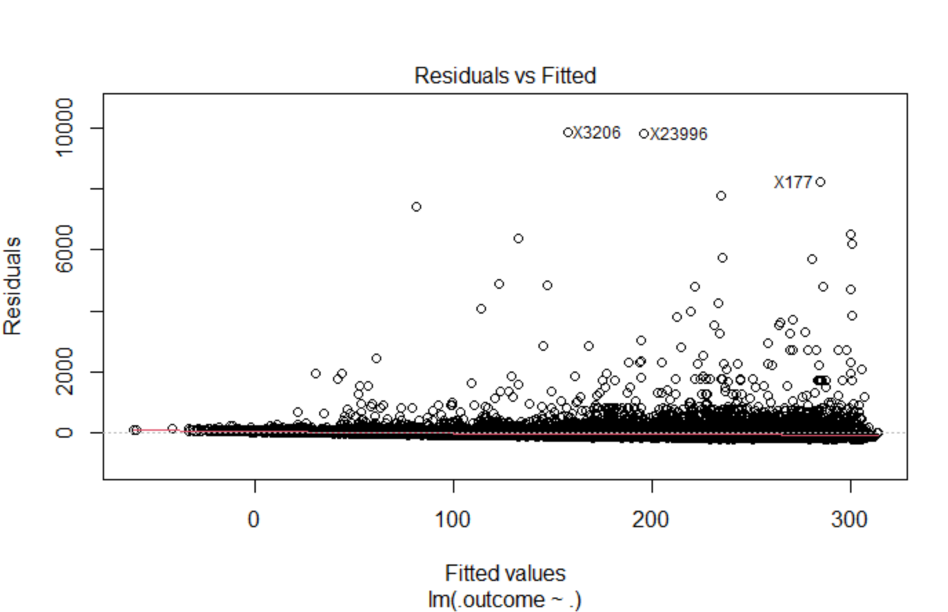
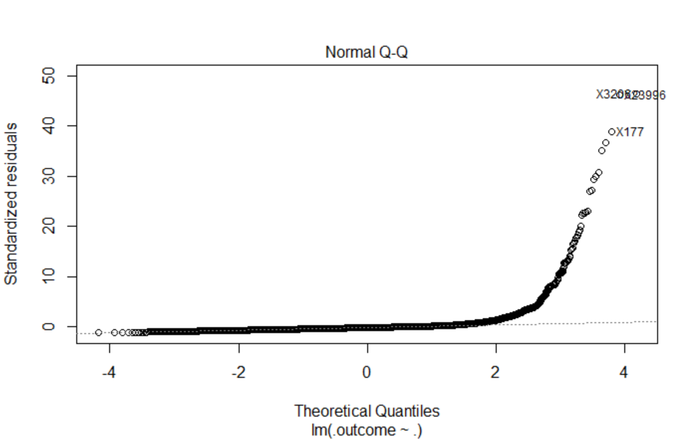
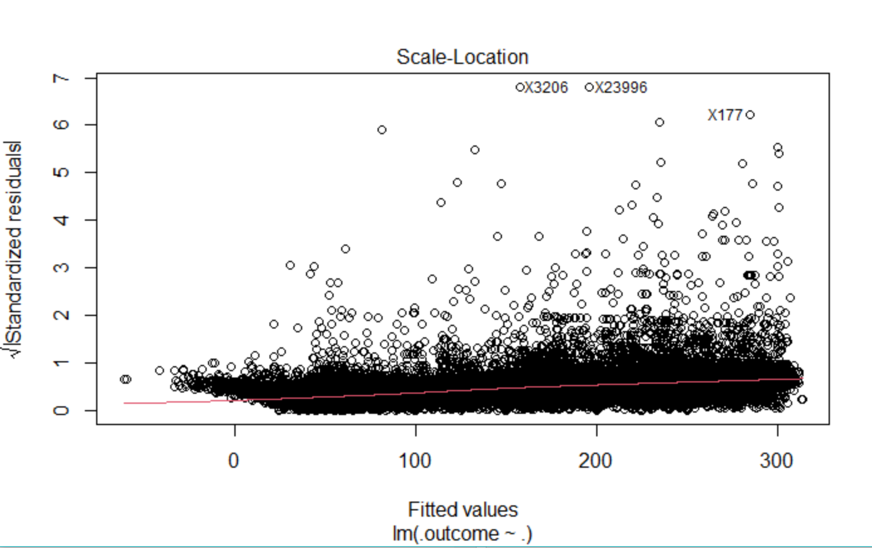
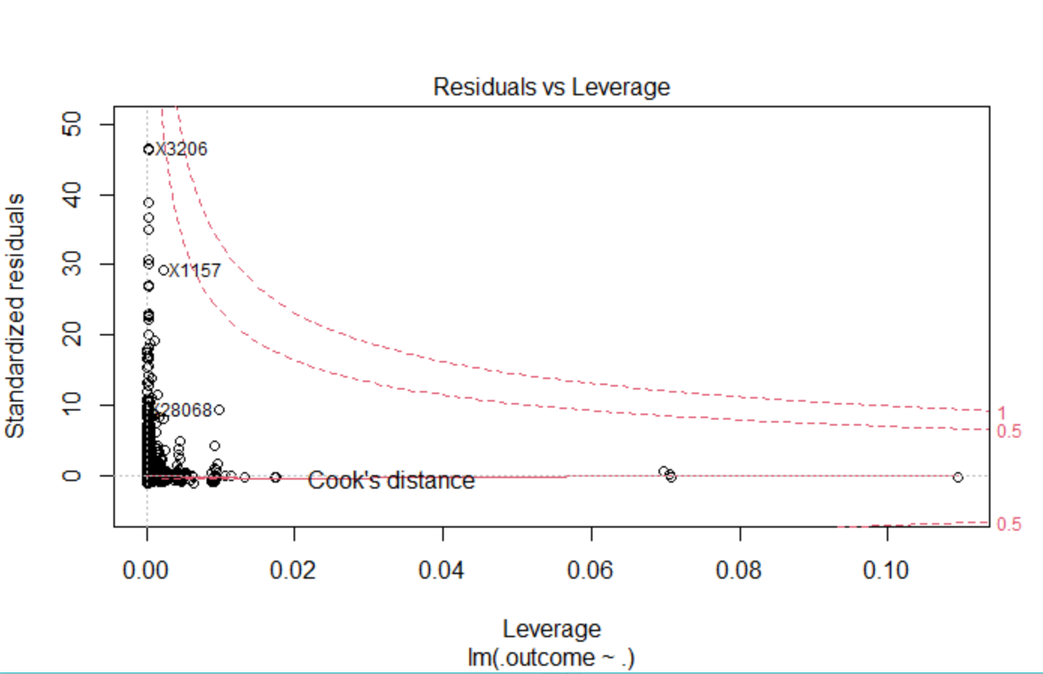
Normal Q-Q plot clearly shows that first linear model doesn’t satisfy linear model assumptions (normal Q-Q plot should be straight line).
Since the model seems bad, it will not be used in predicting new prices.

Slide 14
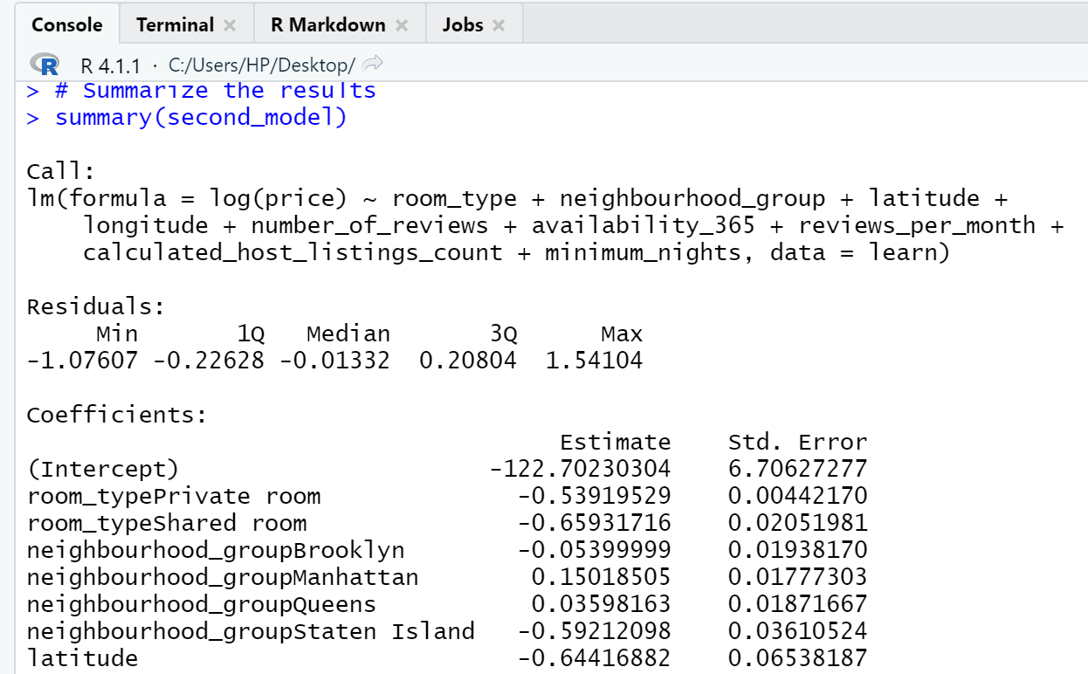
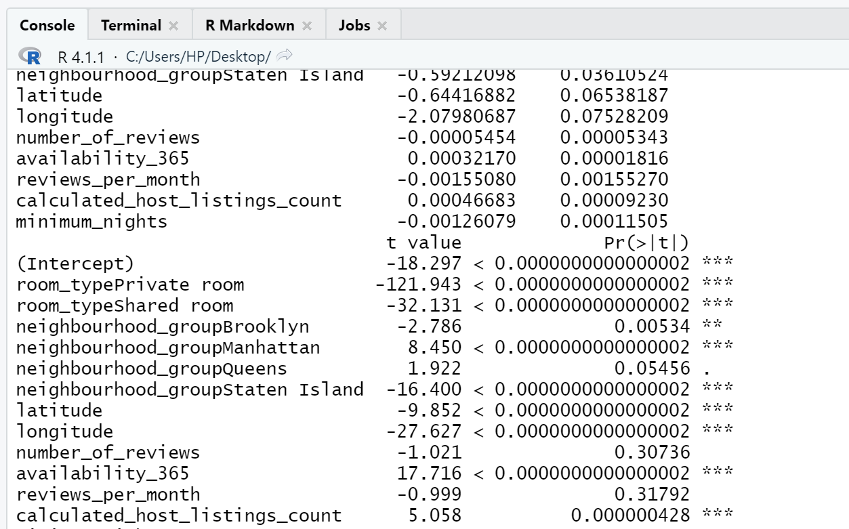
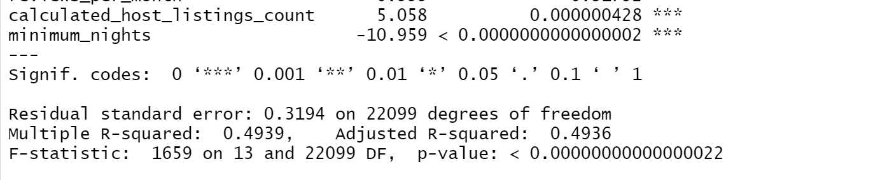
Second model will introduce logarithmic transformations. Also, training dataset will be filtered by price so outliers are removed.
In 2nd model, we selected all variables and we got pretty good result. We got adjusted R2 0.49 but few variables in this model are not significant.

Slide 15
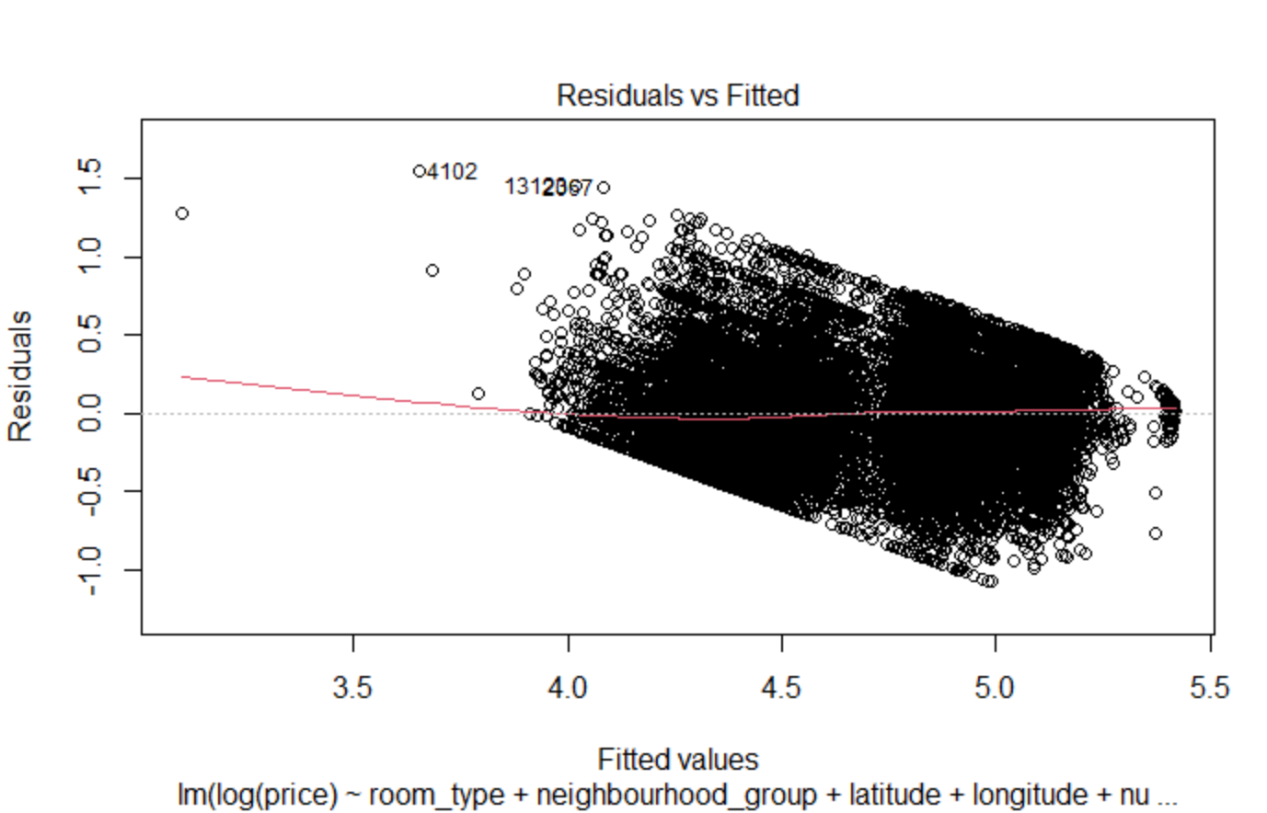
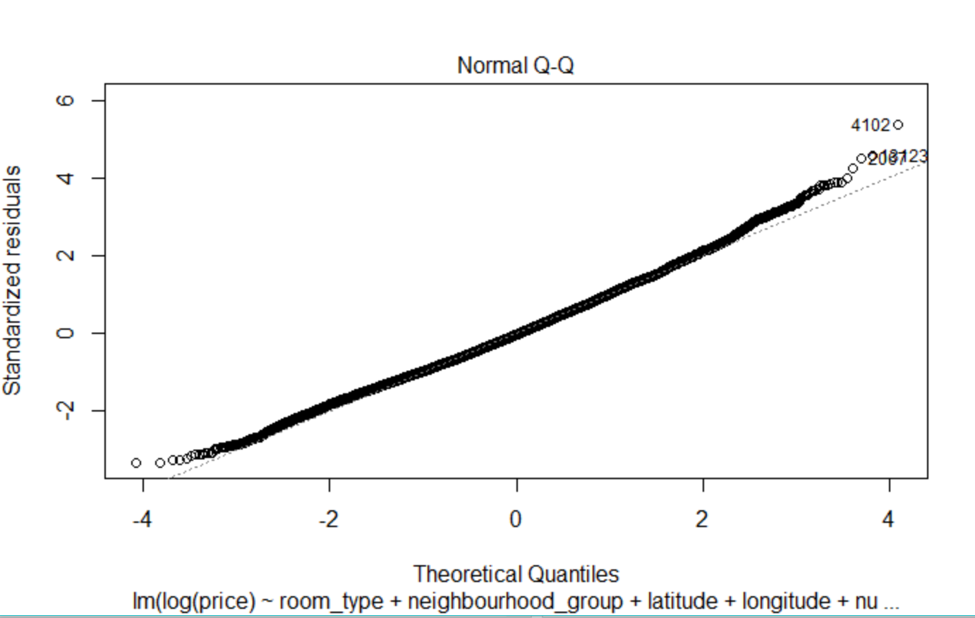
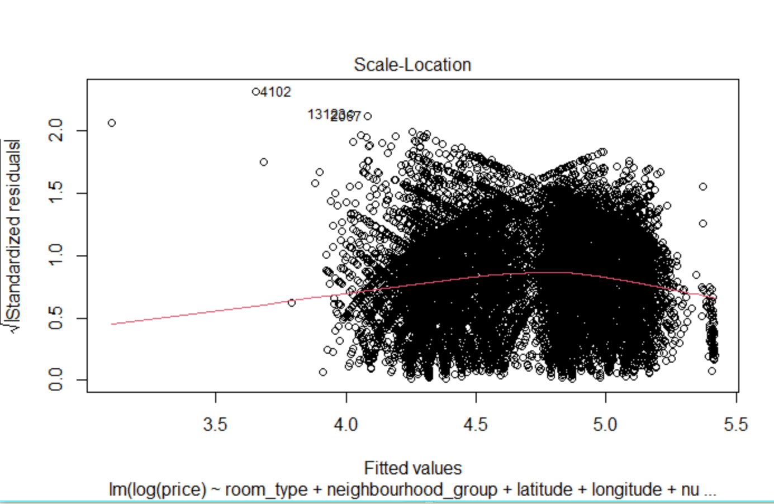
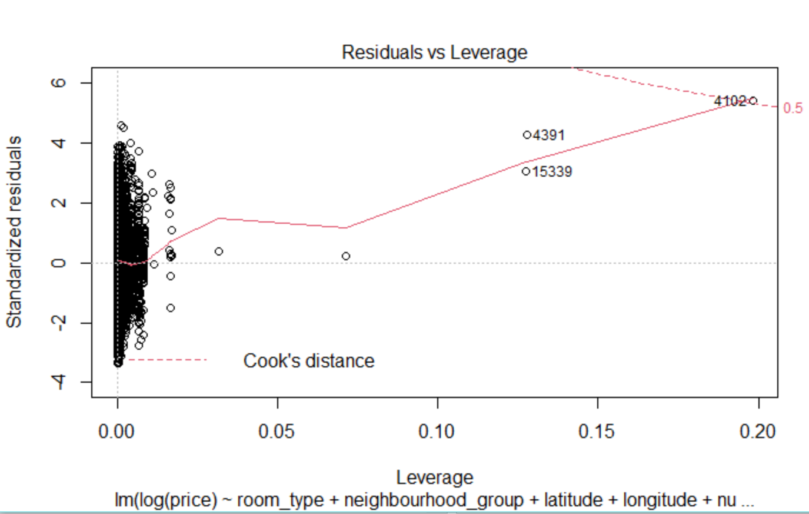
This model is an improvement. Median residual error is now -0.0133, which is far better than -23.8 from the first model. R2=0.49 means that this model explains about 50% variance of target variable.
plot(second_model) .
Normal Q-Q plot for this model looks much better then for the previous one.

Slide 16
CONCLUSIONS
This study predicts the price per night for NYC Airbnb listings. We explored all the variables affecting price of listings in exploratory analysis. All variables are significant except calculated host listing and last reviews but not enough for this study. We gained following insights from the data, which can answer our research question:
• Neighbourhood group and property type are important factors. • Manhattan has the most expensive properties compare to other neighbourhood groups. • Brooklyn is the good choice with average price and number of reviews. • Expensive property has a smaller number of reviews than low or average price range properties. • Availability of room did not guarantee a higher average listing price.
Using multiple linear models, we see that the duration prediction has a good fit of training data with generalization error, but prediction of pricing per night seems to yield periodically increasing loss, which is something that should be addressed in future work.

Slide 17
FUTURE WORK
• There are several limitations in this study. Future studies should explore the influence of other factors like season, property insights, crime rate of neighbourhood, and monthly Airbnb host revenue.
• We will try to analysis the name of the listing by text mining technique. So that we can find best words to use in the listing.
• We will explore this data more in the future with different advanced predictive modelling techniques like Decision Tree, Random Forest, and Support Vector machine to improve predictive power.

